Slide 1
Computer Networks
CS 430

Slide 2
Transport Layer

Slide 3
Objectives
Transport-layer services
Multiplexing and demultiplexing
Connectionless transport: UDP
Principles of reliable data transfer
Connection-oriented transport: TCP
segment structure
reliable data transfer
flow control
connection management
Principles of congestion control
TCP congestion control

Slide 4
Transport Services
Logical communication between applications
End system protocol
TCP vs UDP
Application layer
Messages
Transport layer
TCP segments
UDP datagrams
Network layer
Packets
Link-local
Frames

Slide 5
Transport vs. Network Layer
Transport layer
Network layer
Protocol(s)
TCP, UDP
Communication between
Processes
Identifier used
Port
Reliability
Possible
Protocol(s)
IP, IPv6
Communication between
Hosts
Identifier used
IP address
Reliability
None

Slide 6
Transport Layer Protocols
TCP
Congestion control
Flow control
Connection setup
UDP
Best-effort delivery
Unavailable services
Delay guarantee
Bandwidth guarantee

Slide 7

Multiplexing/demultiplexing
multiplexing at sender:
handle data from multiple
sockets, add transport header (later used for demultiplexing)
demultiplexing at receiver:
use header info to deliver
received segments to correct
socket
application
application
P1
P2
application
socket
P3
transport
P4
process
transport
network
transport
network
link
network
link
physical
link
physical
physical

Slide 8
How Demultiplexing Works
Host receives IP packet
each packet has source IP address, destination IP address
each packet carries one transport-layer segment
each segment has source, destination port number
Host uses IP addresses & port numbers to direct segment to appropriate socket
32 bits
source port #
dest port #
other header fields
application
data
(payload)
TCP/UDP segment format

Slide 9
Connectionless Demux: Example
DatagramSocket mySocket2 = new DatagramSocket
(9157);
DatagramSocket mySocket1 = new DatagramSocket (5775);
application
application
P1
application
P3
P4
transport
transport
network
transport
network
link
network
link
physical
link
physical
physical
source port: 6428
dest port: 9157
source port: ?
dest port: ?
source port: 9157
dest port: 6428
source port: ?
dest port: ?

Slide 10
Connection-oriented demux
TCP socket identified by 4-tuple
source IP address
source port number
dest IP address
dest port number
demux: receiver uses all four values to direct segment to appropriate socket
server host may support many simultaneous TCP sockets:
each socket identified by its own 4-tuple
web servers have different sockets for each connecting client
non-persistent HTTP will have different socket for each request

Slide 11
Connection-oriented Demux: Example
threaded server
application
application
P4
P5
P6
application
P1
P2
P3
transport
transport
network
transport
network
link
network
link
physical
link
physical
server: IP address B
physical
host: IP address A
source IP,port: B,80
dest IP,port: A,9157
host: IP address C
source IP,port: C,5775
dest IP,port: B,80
source IP,port: A,9157
dest IP, port: B,80
source IP,port: C,9157
dest IP,port: B,80
three segments, all destined to IP address: B,
dest port: 80 are demultiplexed to different sockets

Slide 12
User Datagram Protocol

Slide 13
User Datagram Protocol
RFC 768
Best effort service, UDP segments may be
lost
delivered out-of-order to app
Connectionless
no handshaking between UDP sender, receiver
each UDP segment handled independently of others
UDP use
streaming multimedia apps (loss tolerant, rate sensitive)
DNS, DHCP, NTP, SNMP etc.
Reliable transfer over UDP
Add reliability at application layer
Application-specific error recovery!

Slide 14
UDP: segment header
32 bits
Why UDP?
No connection establishment (which can add delay)
Simple: no connection state at sender, receiver
Small header size
No congestion control: UDP can blast away as fast as desired
MGEN
source port #
dest port #
length
checksum
application
data
(payload)
UDP segment format

Slide 15
UDP Checksum
Sender
Receiver
Treat segment contents, including header fields, as sequence of 16-bit integers
Checksum: addition (one’s complement sum) of segment contents
Sender puts checksum value into UDP checksum field
Compute checksum of received segment
Check if computed checksum equals checksum field value:
NO - error detected
YES - no error detected. But maybe errors nonetheless?

Slide 16
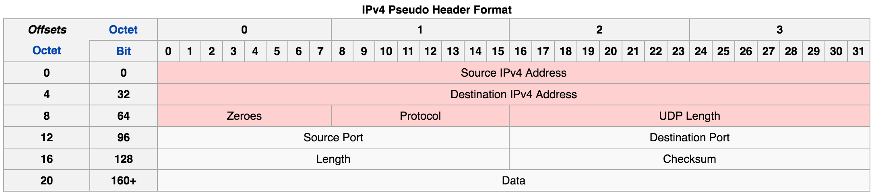
IP Pseudo Header

Slide 17
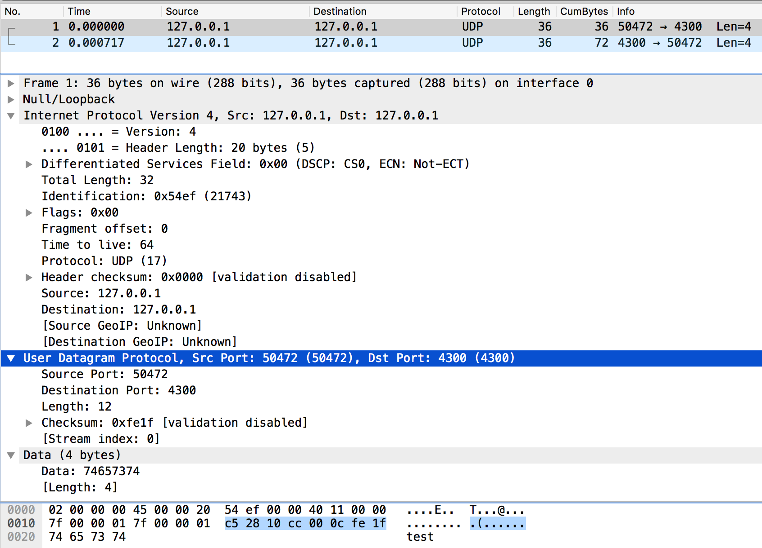
UDP Checksum

Slide 18
UDP Checksum
 | 0 | 1 | 2 | 3 | 4 | 5 | 6 | 7 | 8 | 9 | 10 | 11 | 12 | 13 | 14 | 15
Src IP (1) | 0 | 1 | 1 | 1 | 1 | 1 | 1 | 1 | 0 | 0 | 0 | 0 | 0 | 0 | 0 | 0
Src IP (2) | 0 | 0 | 0 | 0 | 0 | 0 | 0 | 0 | 0 | 0 | 0 | 0 | 0 | 0 | 0 | 1
SUM
Dst IP (1) | 0 | 1 | 1 | 1 | 1 | 1 | 1 | 1 | 0 | 0 | 0 | 0 | 0 | 0 | 0 | 0
SUM
Dst IP (2) | 0 | 0 | 0 | 0 | 0 | 0 | 0 | 0 | 0 | 0 | 0 | 0 | 0 | 0 | 0 | 1
SUM
Zero+Proto | 0 | 0 | 0 | 0 | 0 | 0 | 0 | 0 | 0 | 0 | 0 | 1 | 0 | 0 | 0 | 1
SUM
UDP Length | 0 | 0 | 0 | 0 | 0 | 0 | 0 | 0 | 0 | 0 | 0 | 0 | 1 | 1 | 0 | 0
SUM
Src Port | 1 | 1 | 0 | 0 | 0 | 1 | 0 | 1 | 0 | 0 | 1 | 0 | 1 | 0 | 0 | 0
SUM
Dst Port | 0 | 0 | 0 | 1 | 0 | 0 | 0 | 0 | 1 | 1 | 0 | 0 | 1 | 1 | 0 | 0
SUM
Length | 0 | 0 | 0 | 0 | 0 | 0 | 0 | 0 | 0 | 0 | 0 | 0 | 1 | 1 | 0 | 0
SUM
Chk Sum | 0 | 0 | 0 | 0 | 0 | 0 | 0 | 0 | 0 | 0 | 0 | 0 | 0 | 0 | 0 | 0
SUM
DATA (1) | 0 | 1 | 1 | 1 | 0 | 1 | 0 | 0 | 0 | 1 | 1 | 0 | 0 | 1 | 0 | 1
SUM
DATA (2) | 0 | 1 | 1 | 1 | 0 | 0 | 1 | 1 | 0 | 1 | 1 | 1 | 0 | 1 | 0 | 0
SUM
1s COMP

Slide 19
Reliable Data Transfer

Slide 20
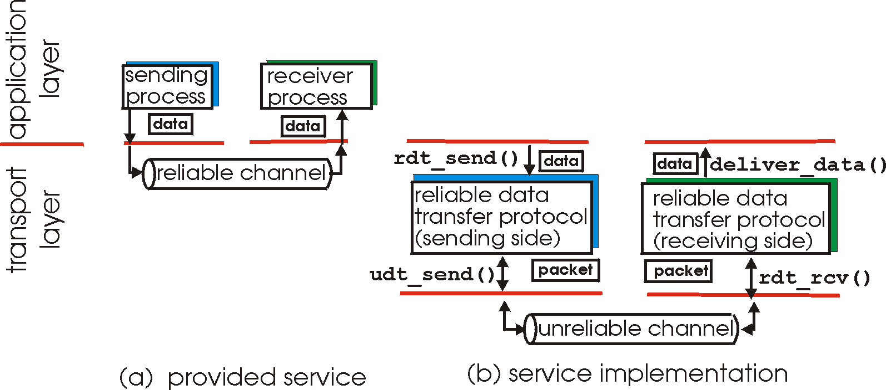
Reliable Data Transfer

Slide 21
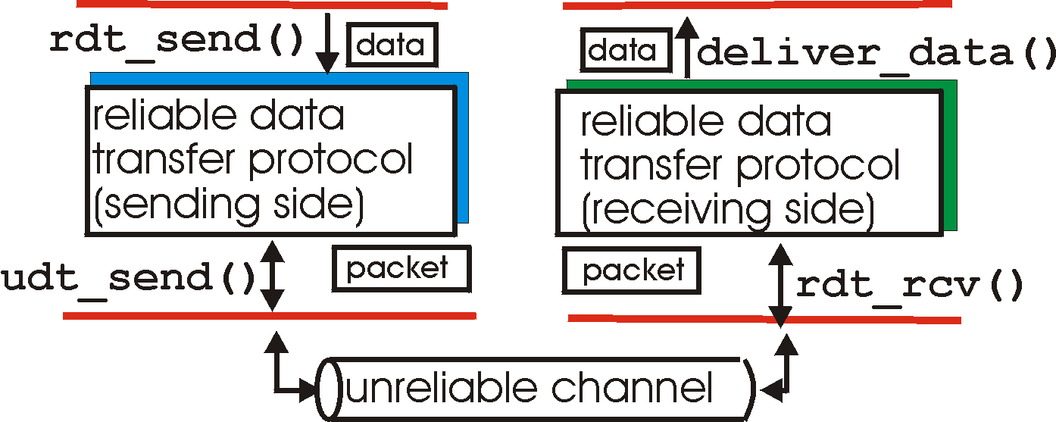
Reliable data transfer: getting started
rdt_send(): called from above, (e.g., by app.). Passed data to
deliver to receiver upper layer
deliver_data(): called by rdt to deliver data to upper
send
side
receive
side
udt_send(): called by rdt,
to transfer packet over
unreliable channel to receiver
rdt_rcv(): called when packet arrives on rcv-side of channel

Slide 22
rdt1 (over a reliable channel)
Wait for call from above
rdt_send(data)
sender
Wait for call from below
rdt_rcv(packet)
receiver

Slide 23
Error Recovery
Error detection
Checksum
ACKnowledgements
OK
Negative ACKnowledgements
Repeat please
Automatic Repeat reQuest (ARQ)
Corrupted ACK/NACK?
Sequence number

Slide 24
rdt2.0 (bit errors possible)
rdt_send(data)
receiver
sndpkt = make_pkt(data, checksum)
udt_send(sndpkt)
rdt_rcv(rcvpkt) &&
isNAK(rcvpkt)
Wait for call from above
Wait for ACK or NAK
rdt_rcv(rcvpkt) &&
corrupt(rcvpkt)
udt_send(sndpkt)
udt_send(NAK)
rdt_rcv(rcvpkt) && isACK(rcvpkt)
Wait for call from below
Λ
sender
rdt_rcv(rcvpkt) &&
notcorrupt(rcvpkt)
extract(rcvpkt,data)
deliver_data(data)
udt_send(ACK)

Slide 25
rtd2.0 Flaw
What if ACK/NAK is corrupted?
Ask to repeat?
Recover from an error?
Send again?
Sequence number
ACKnowledge the last packet
NAK alternative
Duplicate packets
Duplicate ack

Slide 26
rdt2.1 (handle garbled ACK/NAKs)
rdt_send(data)
sndpkt = make_pkt(0, data, checksum)
udt_send(sndpkt)
rdt_rcv(rcvpkt) &&
( corrupt(rcvpkt) ||
isNAK(rcvpkt) )
Wait for call 0 from above
Wait for ACK or NAK 0
udt_send(sndpkt)
rdt_rcv(rcvpkt)
&& notcorrupt(rcvpkt)
&& isACK(rcvpkt)
rdt_rcv(rcvpkt)
&& notcorrupt(rcvpkt)
&& isACK(rcvpkt)
Λ
Λ
Wait for ACK or NAK 1
Wait for
call 1 from above
rdt_rcv(rcvpkt) &&
( corrupt(rcvpkt) ||
isNAK(rcvpkt) )
rdt_send(data)
udt_send(sndpkt)
sndpkt = make_pkt(1, data, checksum)
udt_send(sndpkt)

Slide 27
rdt3.0 (errors and loss)
Assumption
underlying channel can also lose packets (data, ACKs)
Checksum, seq. #, ACKs, retransmissions will be of help … but not enough
Approach
sender waits “reasonable” amount of time for ACK
retransmits if no ACK received in this time
if pkt (or ACK) just delayed (not lost):
retransmission will be duplicate, but seq. #’s already handles this
receiver must specify seq # of pkt being ACKed
requires countdown timer
How long should it wait?

Slide 28
rdt3.0 sender
rdt_send(data)
rdt_rcv(rcvpkt) &&
( corrupt(rcvpkt) ||
isACK(rcvpkt,1) )
sndpkt = make_pkt(0, data, checksum)
udt_send(sndpkt)
start_timer
rdt_rcv(rcvpkt)
Λ
Λ
Wait for
call 0from above
Wait for ACK0
timeout
udt_send(sndpkt)
start_timer
rdt_rcv(rcvpkt)
&& notcorrupt(rcvpkt)
&& isACK(rcvpkt,1)
rdt_rcv(rcvpkt)
&& notcorrupt(rcvpkt)
&& isACK(rcvpkt,0)
stop_timer
stop_timer
Wait for ACK1
Wait for
call 1 from above
timeout
udt_send(sndpkt)
start_timer
rdt_rcv(rcvpkt)
rdt_send(data)
Λ
rdt_rcv(rcvpkt) &&
( corrupt(rcvpkt) ||
isACK(rcvpkt,0) )
sndpkt = make_pkt(1, data, checksum)
udt_send(sndpkt)
start_timer
Λ

Slide 29

rdt3.0 in action
sender
receiver
sender
receiver
send pkt0
pkt0
send pkt0
pkt0
rcv pkt0
rcv pkt0
ack0
send ack0
ack0
send ack0
rcv ack0
rcv ack0
send pkt1
pkt1
send pkt1
pkt1
rcv pkt1
X
ack1
send ack1
loss
rcv ack1
send pkt0
pkt0
rcv pkt0
timeout
resend pkt1
ack0
send ack0
pkt1
rcv pkt1
ack1
send ack1
rcv ack1
send pkt0
pkt0
(a) no loss
rcv pkt0
ack0
send ack0
(b) packet loss

Slide 30
rdt3.0 in action
sender
receiver
sender
receiver
send pkt0
pkt0
send pkt0
pkt0
rcv pkt0
rcv pkt0
ack0
send ack0
send ack0
rcv ack0
ack0
send pkt1
pkt1
rcv ack0
rcv pkt1
send pkt1
pkt1
send ack1
rcv pkt1
ack1
send ack1
ack1
X
loss
timeout
resend pkt1
pkt1
rcv pkt1
timeout
resend pkt1
rcv ack1
pkt1
rcv pkt1
pkt0
(detect duplicate)
send pkt0
send ack1
ack1
(detect duplicate)
ack1
rcv pkt0
rcv ack1
send ack1
rcv ack1
ack0
send ack0
pkt0
send pkt0
pkt0
send pkt0
rcv pkt0
rcv pkt0
ack0
(detect duplicate)
ack0
send ack0
send ack0
(c) ACK loss
(d) premature timeout/ delayed ACK

Slide 31
Performance of rdt3.0
e.g.: 1 Gbps link, 15 ms prop. delay, 8000 bit packet:
L
8000 bits
D_{trans} =
=
=
8 microsecs
R
10⁹ bits/sec
U _{sender}: utilization – fraction of time sender busy sending
if RTT=30 msec, 1KB pkt every 30 msec: 33kB/sec thruput over 1 Gbps link

Slide 32
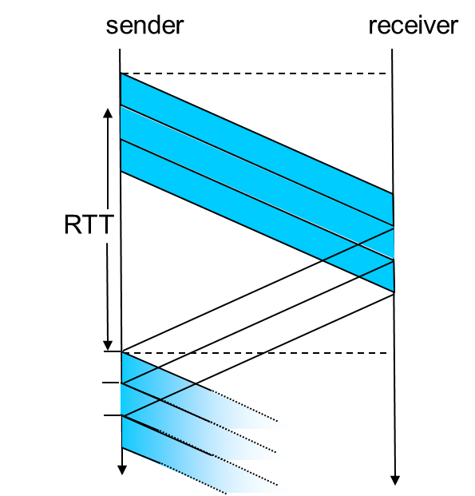
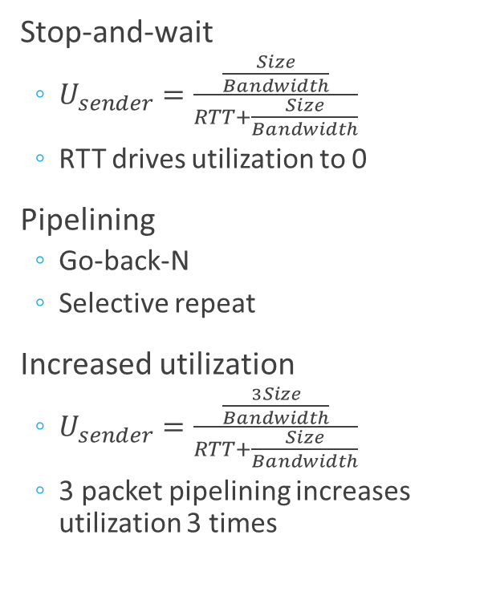
Pipelining
Stop-and-wait
$U_{sender}=\frac{\frac{Size}{Bandwidth}}{RTT+\frac{Size}{Bandwidth}}$
RTT drives utilization to 0
Pipelining
Go-back-N
Selective repeat
Increased utilization
$U_{sender}=\frac{\frac{3Size}{Bandwidth}}{RTT+\frac{Size}{Bandwidth}}$
3 packet pipelining increases utilization 3 times

Slide 33
Pipelined Protocols
Go-back-N
Selective Repeat
sender can have up to N unacked packets in pipeline
receiver only sends cumulative ack
doesn’t ack packet if there’s a gap
sender has timer for oldest unacked packet
when timer expires, retransmit all unacked packets
sender can have up to N unack’ed packets in pipeline
rcvr sends individual ack for each packet
sender maintains timer for each unacked packet
when timer expires, retransmit only that unacked packet

Slide 34
GBN in action
sender window (N=4)
sender
receiver
0 1 2 3 4 5 6 7 8
send pkt0
send pkt1
send pkt2
send pkt3
(wait)
0 1 2 3 4 5 6 7 8
receive pkt0, send ack0
receive pkt1, send ack1
receive pkt3, discard,
(re)send ack1
0 1 2 3 4 5 6 7 8
X
0 1 2 3 4 5 6 7 8
loss
0 1 2 3 4 5 6 7 8
rcv ack0, send pkt4
rcv ack1, send pkt5
0 1 2 3 4 5 6 7 8
receive pkt4, discard,
(re)send ack1
ignore duplicate ACK
receive pkt5, discard,
(re)send ack1
pkt 2 timeout
0 1 2 3 4 5 6 7 8
send pkt2
send pkt3
send pkt4
send pkt5
0 1 2 3 4 5 6 7 8
0 1 2 3 4 5 6 7 8
rcv pkt2, deliver, send ack2
rcv pkt3, deliver, send ack3
rcv pkt4, deliver, send ack4
rcv pkt5, deliver, send ack5
0 1 2 3 4 5 6 7 8

Slide 35
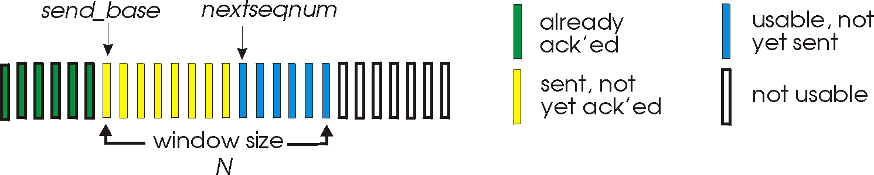
Go-back-N

Slide 36
Selective repeat in action
sender window (N=4)
sender
receiver
0 1 2 3 4 5 6 7 8
send pkt0
send pkt1
send pkt2
send pkt3
(wait)
0 1 2 3 4 5 6 7 8
receive pkt0, send ack0
receive pkt1, send ack1
receive pkt3, buffer,
send ack3
0 1 2 3 4 5 6 7 8
X
0 1 2 3 4 5 6 7 8
loss
0 1 2 3 4 5 6 7 8
rcv ack0, send pkt4
rcv ack1, send pkt5
0 1 2 3 4 5 6 7 8
receive pkt4, buffer,
send ack4
record ack3 arrived
receive pkt5, buffer,
send ack5
pkt 2 timeout
0 1 2 3 4 5 6 7 8
send pkt2
0 1 2 3 4 5 6 7 8
record ack4 arrived
0 1 2 3 4 5 6 7 8
rcv pkt2; deliver pkt2,
pkt3, pkt4, pkt5; send ack2
record ack5 arrived
0 1 2 3 4 5 6 7 8
Q: what happens when ack2 arrives?

Slide 37
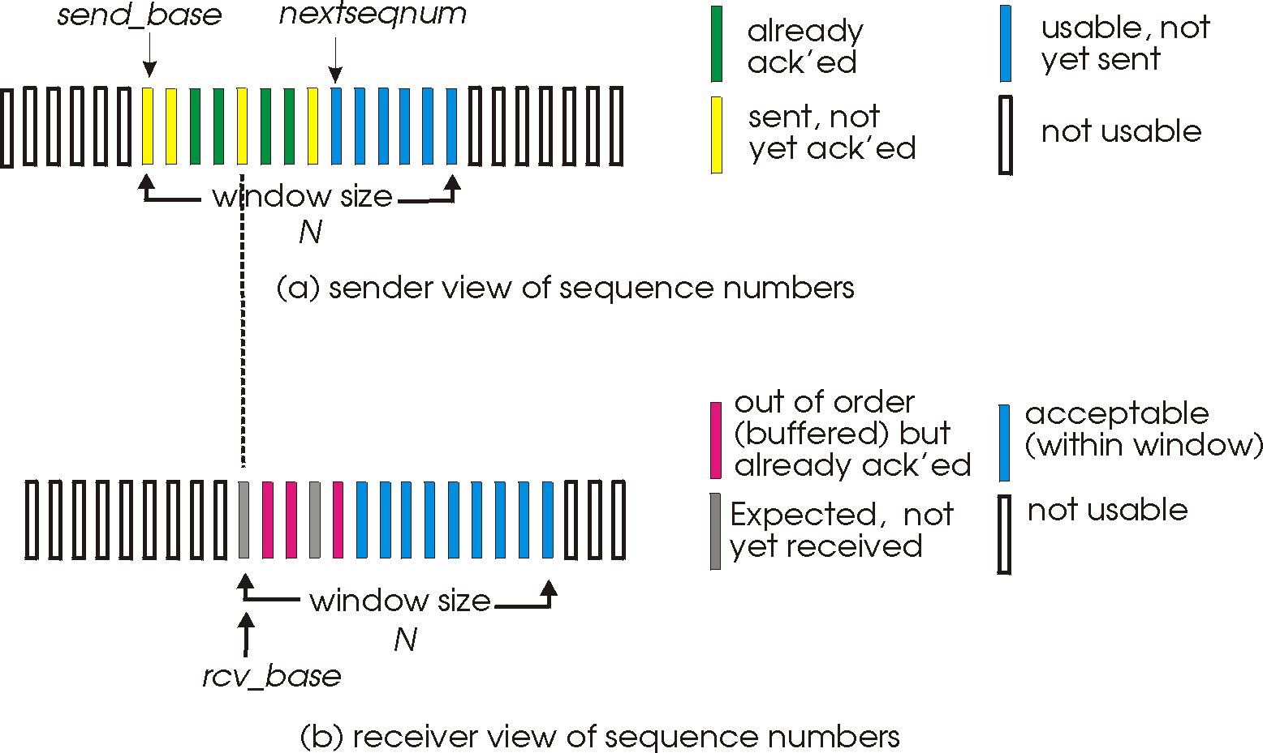
Selective Repeat

Slide 38
Reliable Data Transfer Mechanisms
Mechanism | Comment
Checksum
Timer
Sequence number
Acknowledgement
Negative acknowledgement
Pipelining

Slide 39
Reliable Data Transfer Mechanisms
Mechanism | Comment
Checksum | Error detection
Timer | Retransmission
Sequence number | Detection of lost segments
Acknowledgement | Confirm segment delivery
Negative acknowledgement | Retransmission request
Pipelining | Restrict s segments to be sent

Slide 40
Summary
Transport-layer services
Multiplexing and demultiplexing
Connectionless transport: UDP
Principles of reliable data transfer
Connection-oriented transport: TCP
segment structure
reliable data transfer
flow control
connection management
Principles of congestion control
TCP congestion control

Slide 41
Thank You!

